Slide 1
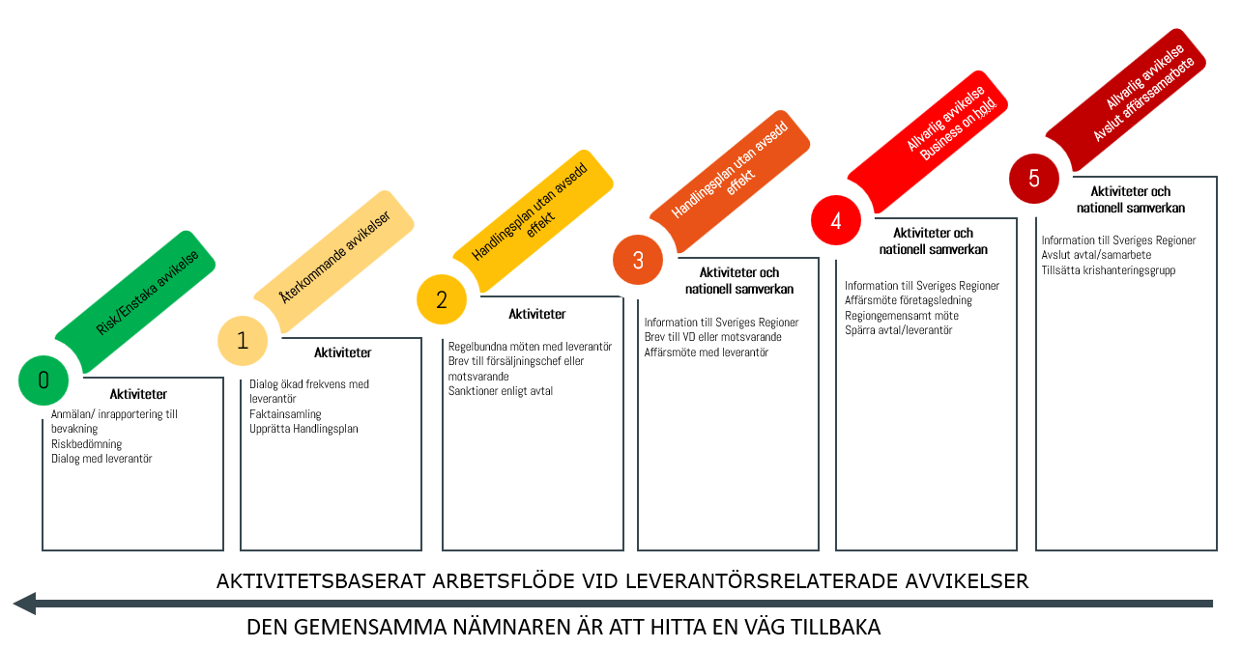
The Regions’ Joint Escalation Ladder
for Sustainable Procurement 2026
Recommendation for an activity-based workflow for supplier-related deviations
Termination of
Business cooperation
Business on hold
LfU’s model within our work
Read more: https://www.lfu.se/eskaleringstrappa
Sanctions ineffective
5
Action plan without intended
effect
4
During continued follow-up or incident management:
Decisions on termination of agreements are made individually by regions
Possible exclusion from individual regions’ future procurements
Information from the secretariat to the regions and external partners
3
During continued follow-up or incident management:
Decisions on suspension of call-offs are made individually by regions
Information from the secretariat to the regions and external partners
Contractual deviation
2
If deviations still remain
after sanctions in follow-up or incident management:
Continued dialogue and follow-up with the supplier
Assessment of further sanctions by individual regions
Information from the secretariat to the regions and external partners
1
Re-audit 2 is carried out.
If failed re-audit 2/​the supplier demonstrates seriously deficient cooperation/ if an action plan in incident management is not followed:​
​
A warning letter is sent to the supplier regarding potential sanctions
Information from the secretariat to the regions​
​
Decisions on sanctions are made by each individual region​
After failed audit:
The supplier prepares an action plan
Re-audit 1 is carred out.
If failed re-audit 1:
An information letter is sent to the supplier
In the event of a “probable/confirmed severe deviation” in incident management:
Continued dialogue with the supplier
The supplier prepares an action plan
The common denominator is finding a way back

